Slide 1
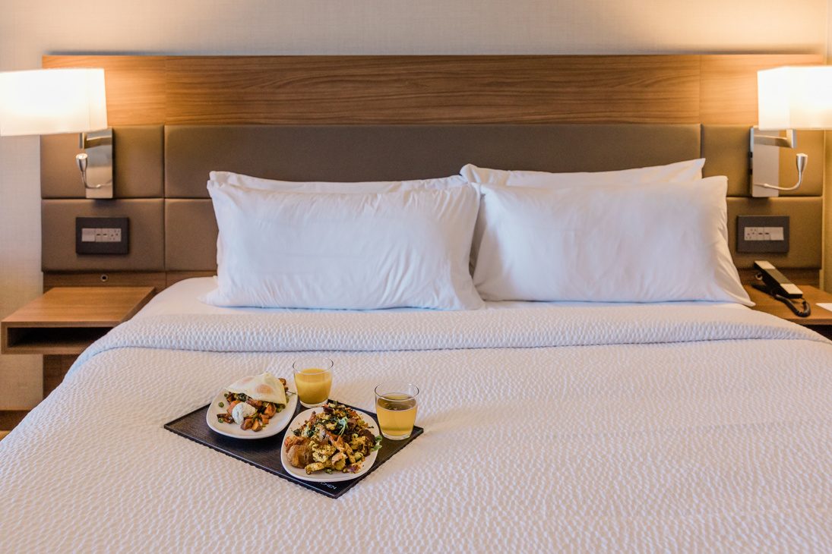

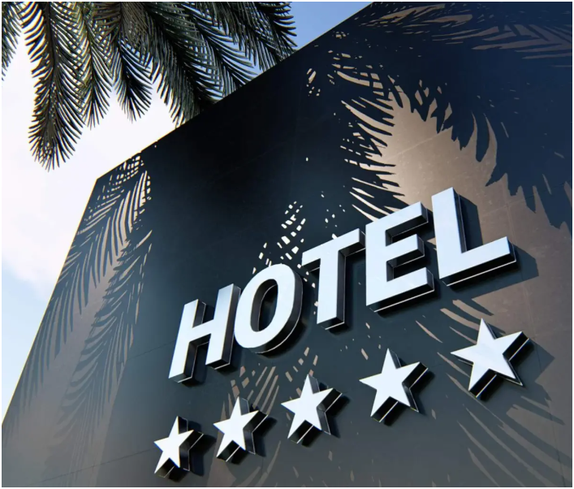
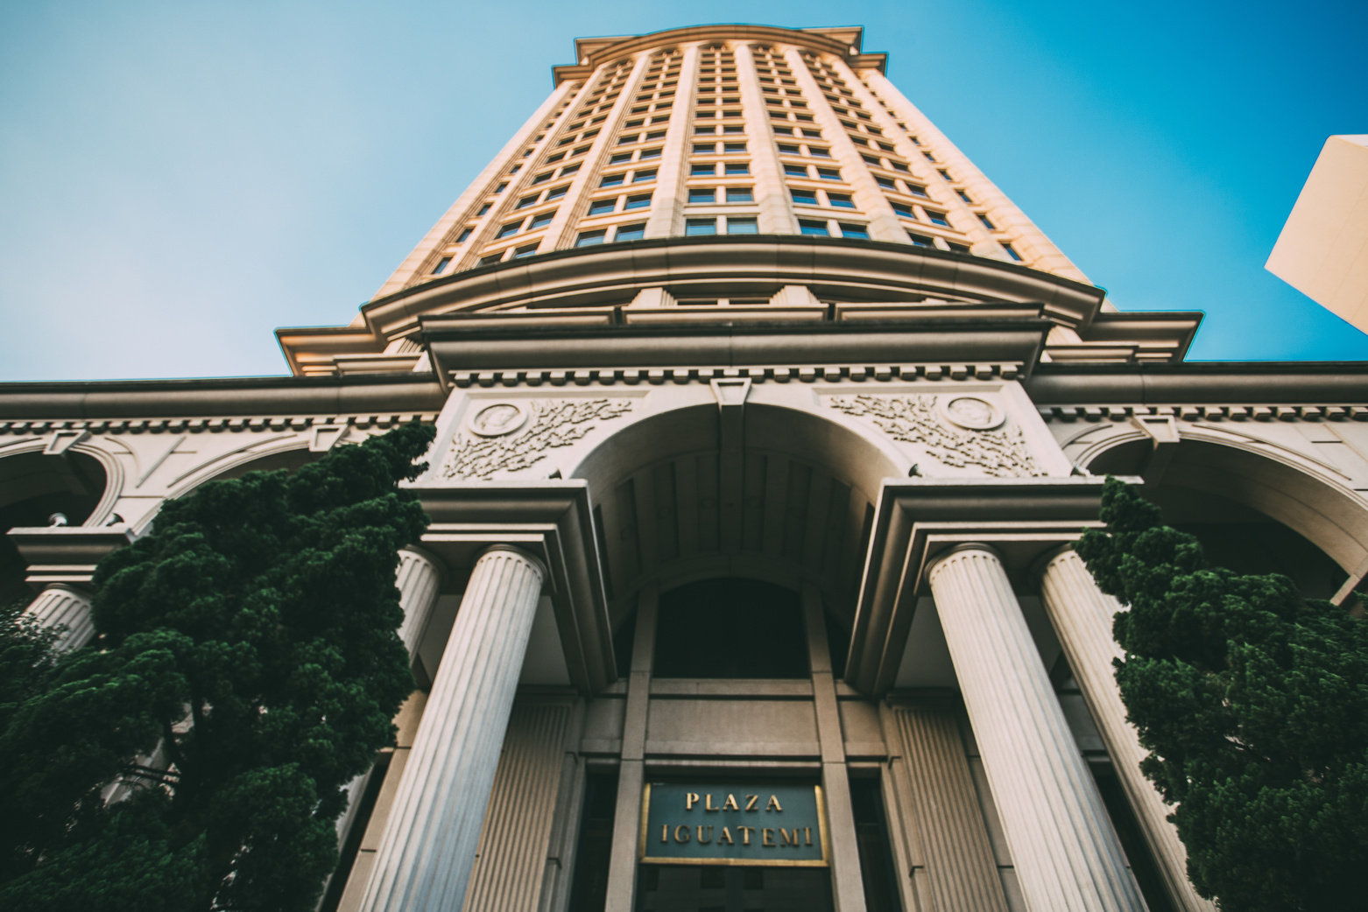
Hotel Review Sentiment Analysis
& Rating Prediction
DSC511: Big Data Analytics
Maria Tsilidou, Anastasios Nikodimou, Ioannis Demetriou

Slide 2
Overview
Introduction
Dataset Description and Cleaning
Exploratory Data Analysis
Natural Language Processing
Graph Analysis
Machine Learning
Limitations
Conclusion

Slide 3

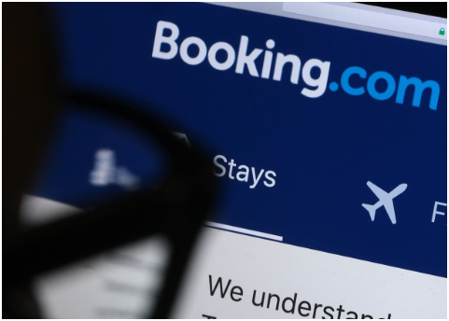
Introduction & Motivation
The Digital World of Hotel Booking
Today, most people read online reviews before choosing a hotel.
Websites like Booking.com are full of real experiences from travelers.
Analyzing Reviews Can...
Identify common issues across different hotels
Help hotels improve their services based on real guest experiences
Project Objectives
Understand review patterns:
Analyze how guests express opinions in positive and negative terms.
Predict user satisfaction:
Use machine learning to predict the overall hotel rating based on review text.

Slide 4


Variable Name | Description
Hotel_Address
Review_Date
Average_Score | Hotel’s average rating.
Hotel_Name
Reviewer_Nationality | Country of origin of the reviewer.
Negative_Review
Review_Total_Negative_Word_Counts
Positive_Review
Review_Total_Positive_Word_Counts
Reviewer_Score | The score the reviewer gave to the hotel.
Total_Number_of_Reviews_Reviewer_Has_Given | Total reviews written by this reviewer.
Total_Number_of_Reviews | Total number of reviews the hotel has received.
Tags | Descriptive tags (e.g., "Business trip", "Solo traveler").
days_since_review | Days between the review date and the data collection date.
Additional_Number_of_Scoring | Number of score-only ratings (no text review) for the hotel.
lat | Latitude of the hotel’s location.
lng | Longitude of the hotel’s location.
Dataset
Description
Source: Booking.com
Size: over 515,000 reviews
Hotels Covered: 1,493 hotels across Europe
Fields Included: 17 variables

Slide 5


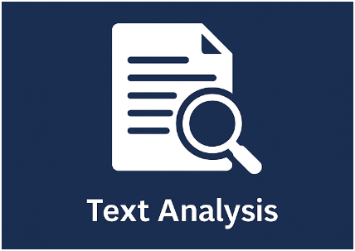

What We Used in Our Project
We built a system that suggests hotels to users using the graph analysis. For each hotel and customer, we generated ids. Those ids were used to identify a unique customer and which we recommended 10 different hotels.
We trained models to predict review sentiment or hotel satisfaction using structured features and text, improving our understanding of what influences guest ratings.
We used graph-based techniques to explore relationships between reviewers and hotels (e.g., shared nationalities or common reviews), identifying patterns and influential nodes.
We analyzed positive and negative reviews by cleaning, tokenizing, and extracting features like word counts or sentiment, helping us understand what guests liked
or disliked.

Slide 6
Dataset Description and Cleaning
Poorly encoded missing values (empty characters, ‘none’, ‘NA’ etc).
‘No Positive’ and ‘No Negative’ in described the absence of positive or negative review, respectively.
Duplicated values were found.
Longitude and latitude represented as strings instead of numeric. They also contained missing values.
Time related features were typed as string

Slide 7
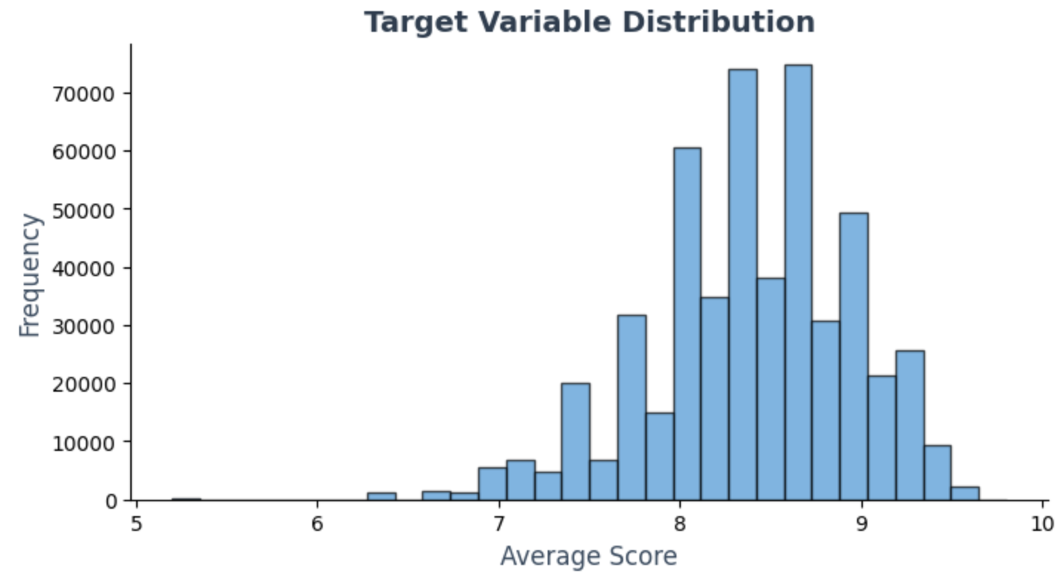
Exploratory Data Analysis
Visualizing a sample of dataset
Average hotel reviews are left skewed
Concentrated around 8.4
Investigation showed hotels in dataset were luxury

Slide 8
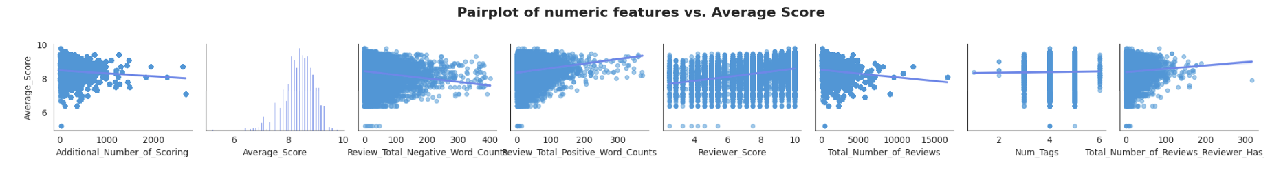
Exploratory Data Analysis
Individual reviewer review Reviewer_Score, and the total "positive" words used in the review Review_Total_Positive_Word_Counts is positively correlated with Average_Score.
The more reviews a user has given Total_Number_of_Reviews_Reviewer_Has_Given is also positively correlated with the venue's average score.
We expected that Review_Total_Negative_Word_Counts negatively correlates to a venue's average score.
The more reviews a venue has Total_Number_of_Reviews, the smaller its average score.
Presence of linear relationship is an suggest that linear models will perform well.

Slide 9
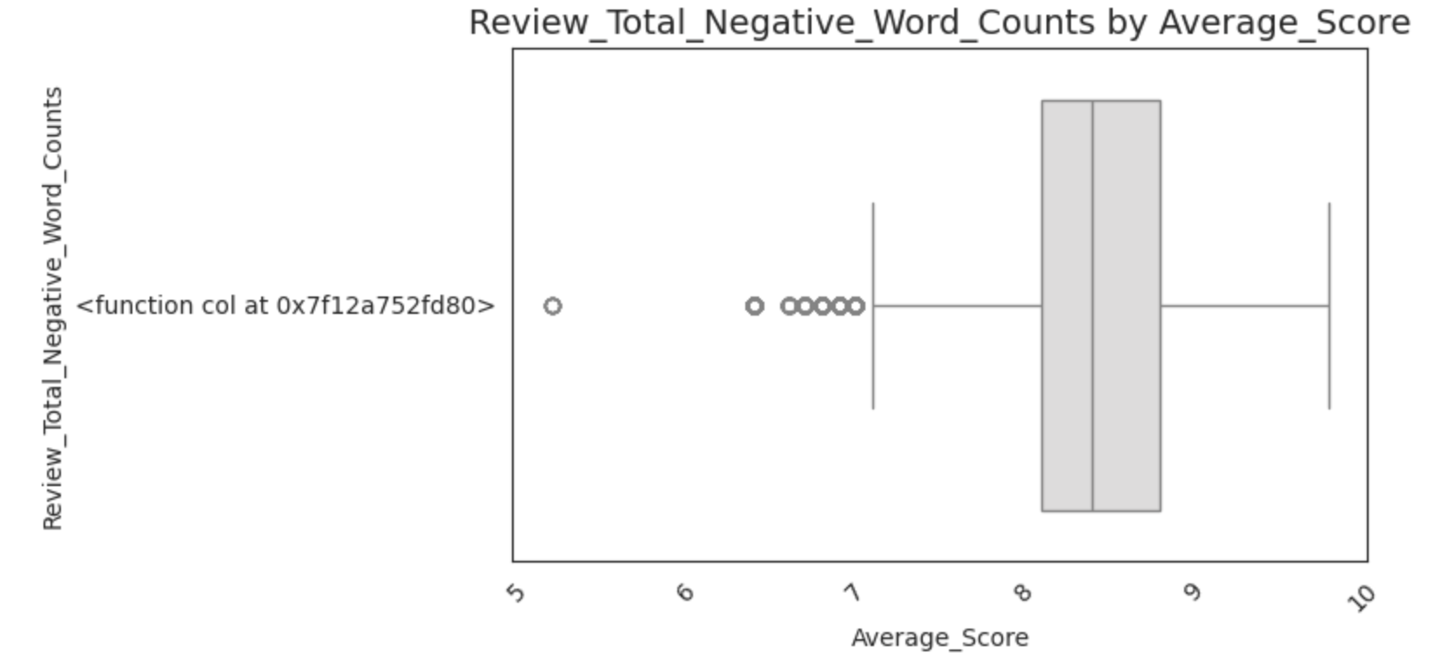
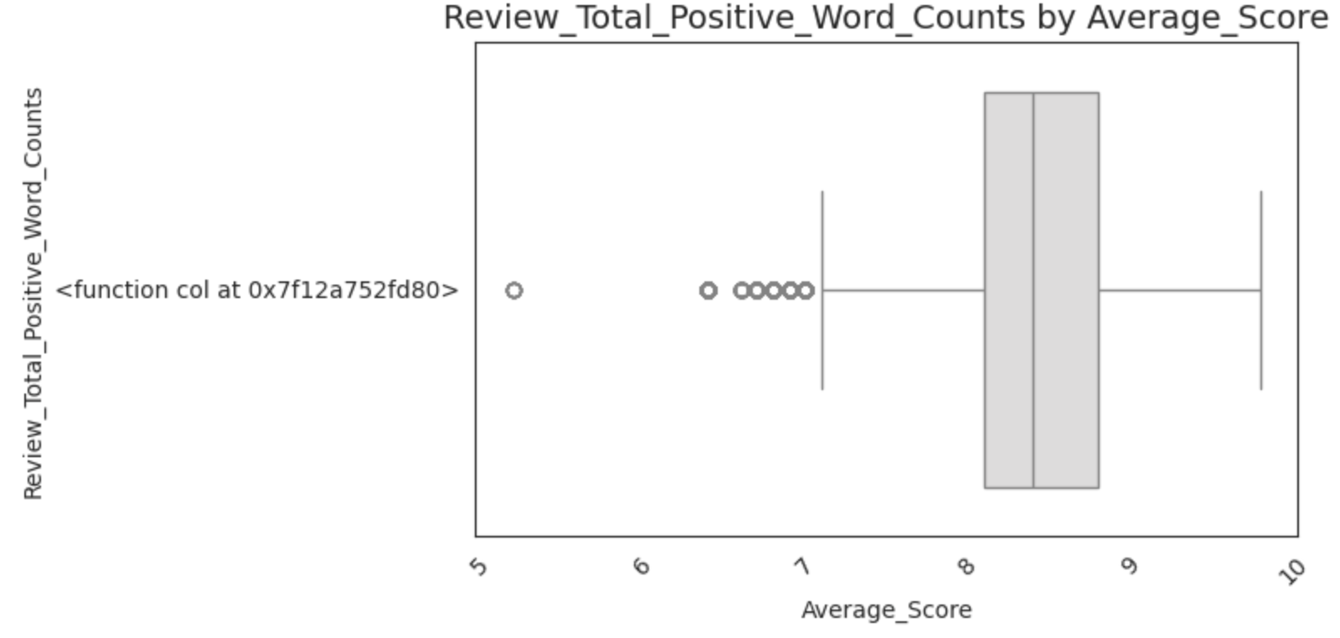
Exploratory Data Analysis
Review_Total_Negative_Word_Counts by Average_Score:
There’s a slight downward trend: as Average_Score increases, the number of negative words tends to decrease.
The median is generally lower for higher scores.
The distribution is very wide at each score — especially for mid-range scores (e.g., 7.0 to 8.5), meaning high variability in how many negative words are used regardless of rating.
Many outliers, especially in lower scores, suggest some extreme reviews with very high negativity.
Review_Total_Positive_Word_Counts by Average_Score:
Positive trend: as Average_Score increases, the number of positive words also increases.
The median positive word count rises steadily from low to high scores.
Whiskers and outliers increase with higher scores — people who are more satisfied tend to say more and more positive things.

Slide 10
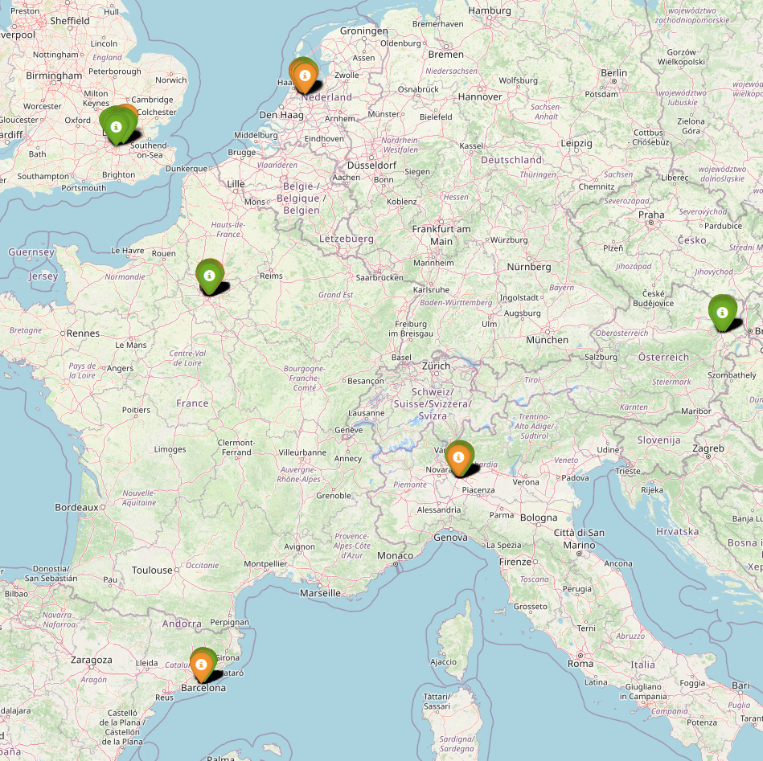
Geographical Distibution
Vienna, Austria
Paris, France
Amsterdam, Netherlands
Barcelona, Spain
Milan, Paris
London, United Kingdom

Slide 11
Reviewer ID was not provider
Engineered reviewer identifier using
Reviewer_Nationality: which gives geographic context of the reviewer.
Tags: reflects the type of traveler (e.g., 'Solo', 'Couple').
Total_Number_of_Reviews_Reviewer_Has_Given: adds some numeric uniqueness.
Graph Analysis

Slide 12
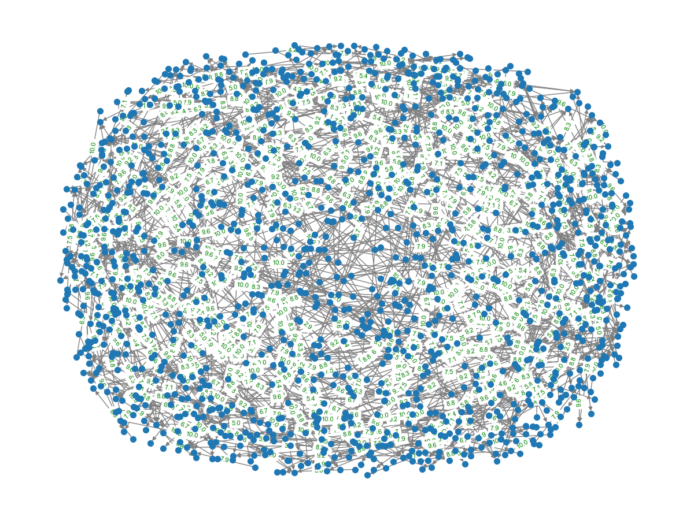
Reviewer - Hotel
Nodes: Reviewer and Hotels
Links: Ratings

Slide 13
Interpretation of the graph
Dataset large Graph not interpretable
We created a code to manually rank the 10 most reviewed hotels
Some of those hotels were 'Strand Palace Hotel' (2525) with average score 8.1, 'Copthorne Tara Hotel London Kensington' (2231)with average score 8.1, 'Britannia International Hotel Canary Wharf' (2112) wiha average score 7.1, 'Hotel Da Vinci' (1783) with avrage score 8.1, 'Millennium Gloucester Hotel London' (1650) with average sc ore 7.8

Slide 14
Reviewer Identifier (Engineered) - Hotel Name
Alternative Least Squares (ALS)
80-20 Train / Validation Split
Collaborative
Filtering

Slide 15
Collaborative Filtering
reviewer_id_index | hotel_id_index | rating
12 | 4 | 8.33
12 | 712 | 5.44
12 | 101 | 5.23
12 | 123 | 5.02
12 | 91 | 4.97
12 | 376 | 4.73
12 | 1251 | 4.71
12 | 445 | 4.68
12 | 36 | 4.65
12 | 527 | 4.44
Root Mean Square Error = 7.15

Slide 16
Reviews split in "Negative" and "Positive"
Can use as labels for sentiment analysis
Natural
Language
Processing

Slide 17
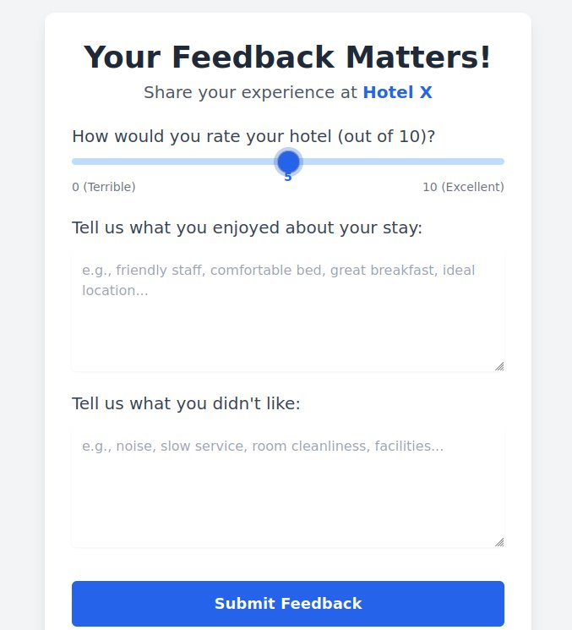
Natural
Language
Processing

Slide 18
Natural Language Processing
"nothing all great"
"no positive"
"no negative"
"staff at bar very friendly"
"bathroom small"

Slide 19
Natural Language Processing
Tokenization
Text Cleanup
Stop Word Removal
Lemmatization (nltk)

Slide 20
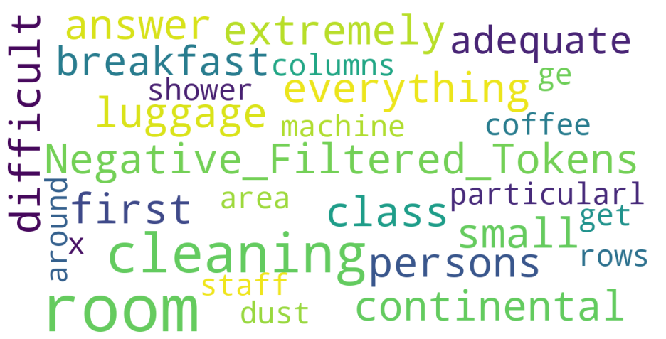
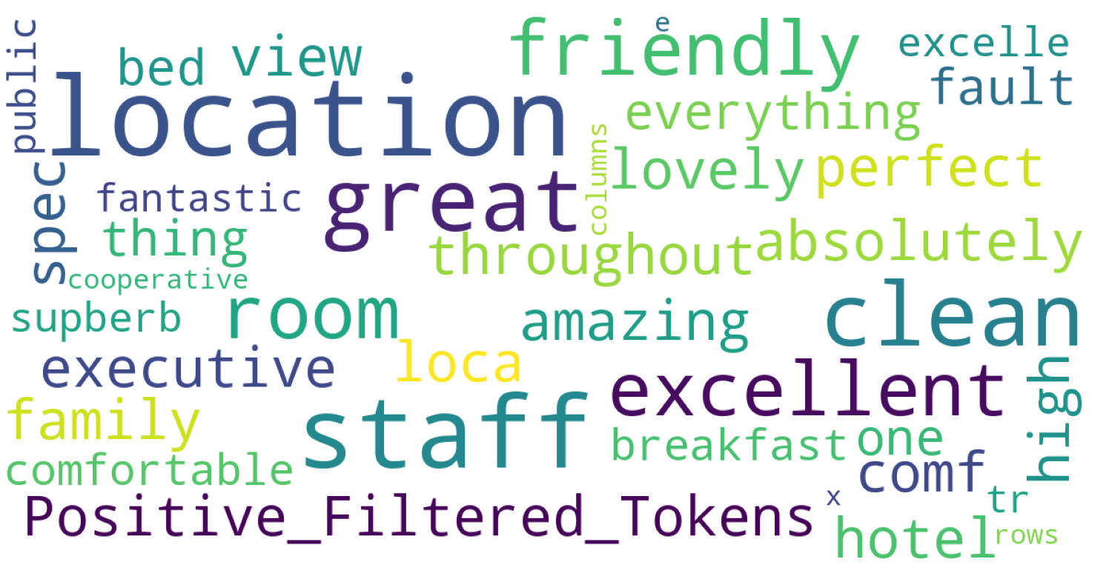
Natural Language Processing
Negative Tokens
Positive Tokens

Slide 21
Machine Learning Techniques

Slide 22
Linear Regression Model
Generated an aggregations for the numeric columns over each hotel in the dataset to calculate the averages.
Cross-validation was not used during this process.
Working from a sample by performing selective sampling and keeping only the hotels with the most reviews (48858 / 515212).
Building a regression model to predict the average hotel review score based on aggregated features derived from user reviews.
Taking a sample from the aggergated dataset (1415 / 515212).
We then filter out hotels with fewer than 30 reviews and those missing geographic data.
Evaluation: Using RMSE and R^2
RMSE on test set: 0.3 and R² on test set: 0.49
The results indicate a moderate predictive performance could potentially be improved by using more complex models (like Random Forest or Gradient Boosting)

Slide 23
GBT and Random Forest evaluation
Results:
Linear Regression - RMSE: 0.3776, R²: 0.4913 Random Forest - RMSE: 0.3810, R²: 0.4820 Gradient Boosted Trees - RMSE: 0.4255, R²: 0.3539
Linear Regression performs best among the three models
LR captures the underlying patterns in your aggregated dataset more effectively, so this implies that our data relationships are relatively linear, or at least well-approximated by a linear function at this aggregation level.

Slide 24
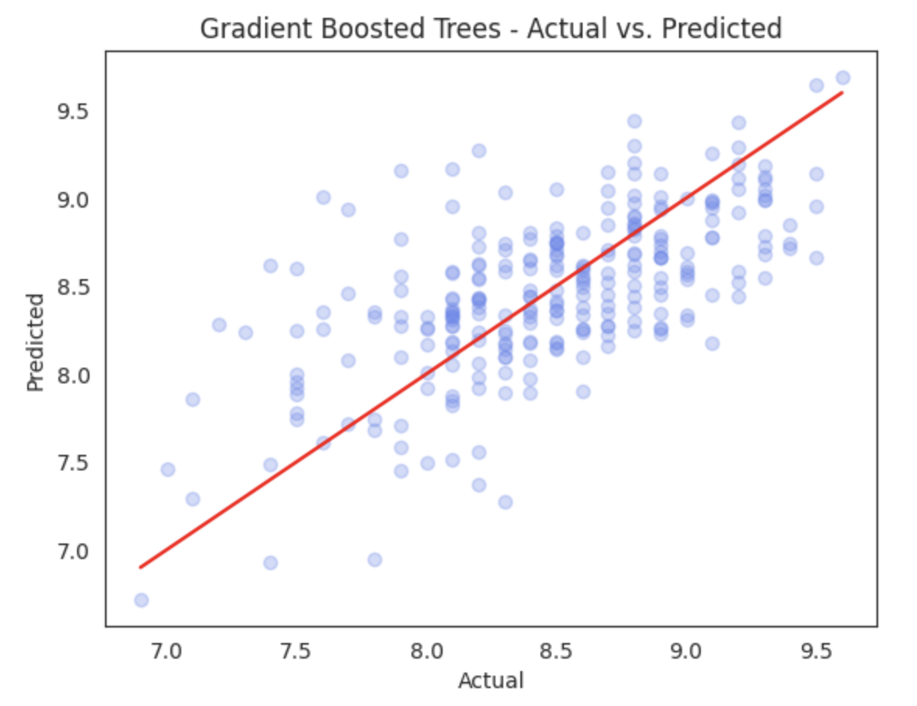
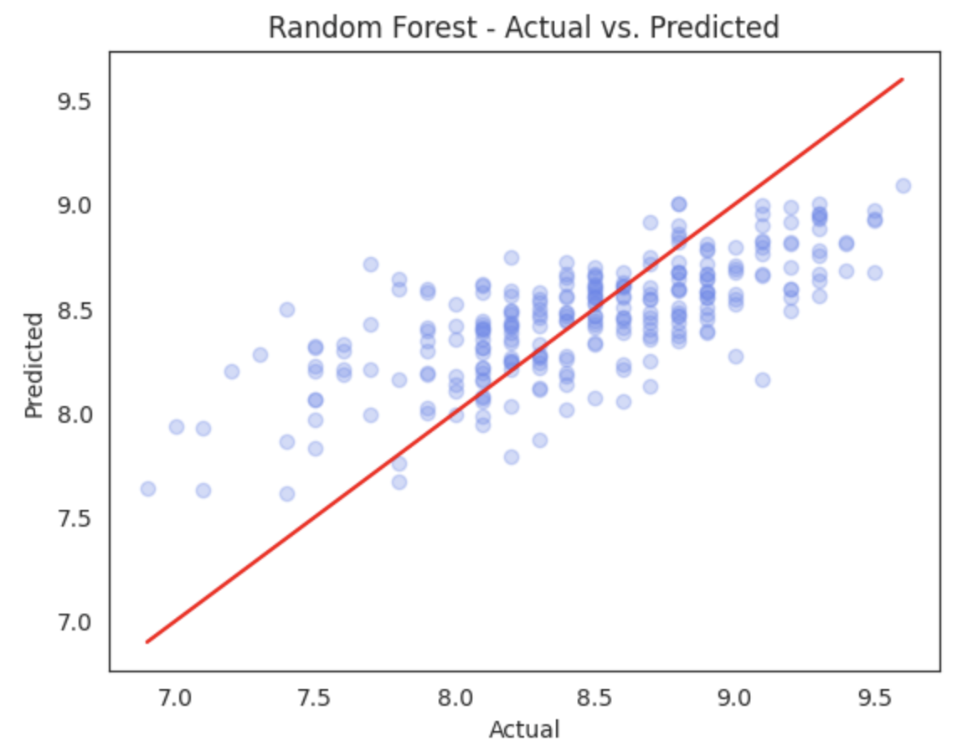
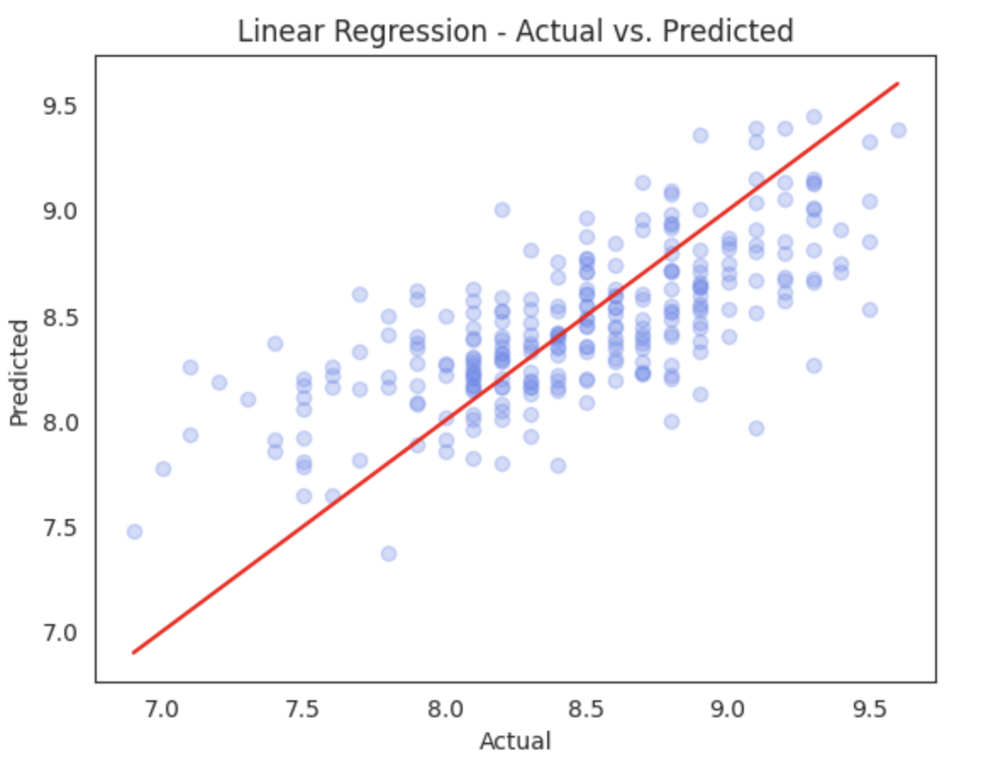
Scatter plots of actual vs the predicted values

Slide 25
MODEL 3 Sentiment Classification Approach

Slide 26
Model 3: Sentiment Classification Approach
We separated the positive and negative parts of each hotel review.
Each part was treated as a separate training example:
Positive comments → Label 1
Negative comments → Label 0
This helped us to :
isolate clear sentiments by separating the positive and negative parts of the reviews.
We converted text to numbers using HashingTF and IDF
Trained a Logistic Regression model to predict sentiment
Notes:
Data Preparation
Kept only meaningful reviews (ignored “No Positive” or “No Negative”).
Created a labeled dataset with:
label = 1 for positive reviews
label = 0 for negative reviews
Text Processing Pipeline
Tokenizer: Split review text into words
StopWordsRemover: Removed common non-informative words
HashingTF: Converted words to numeric vectors
IDF: Scaled word importance

Slide 27
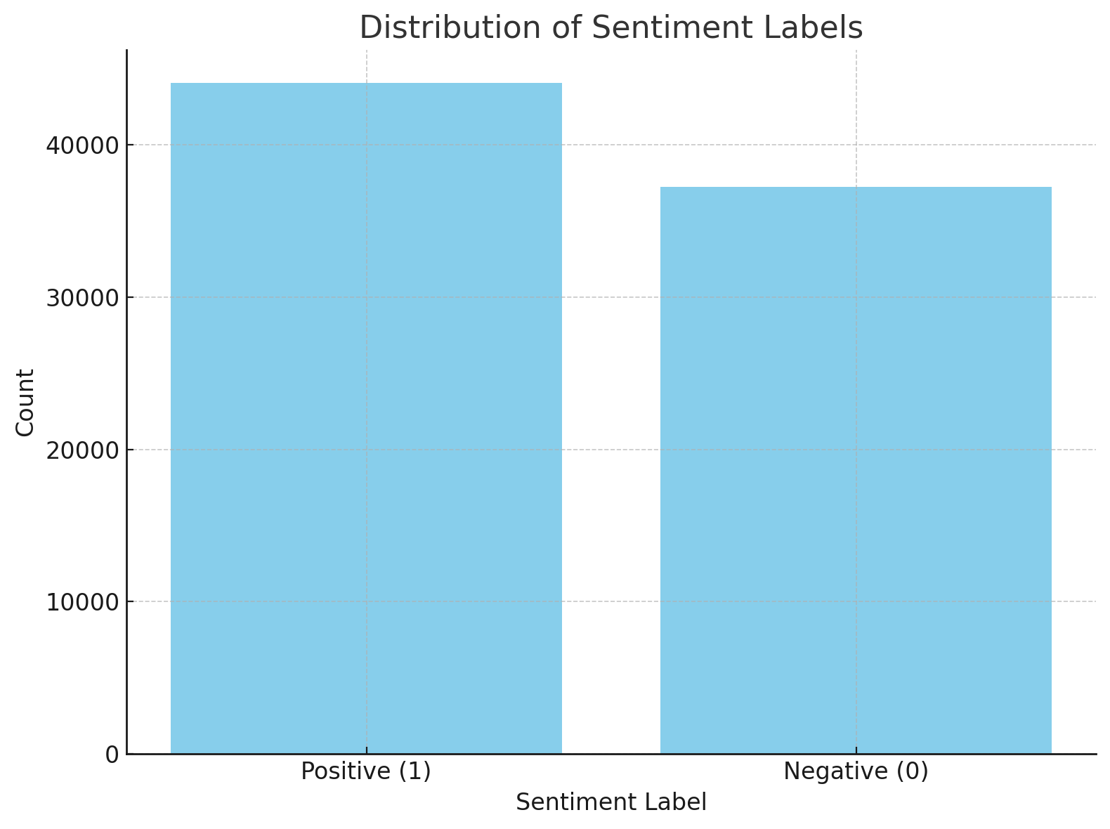
Model 3: Sentiment Classification Approach
In this step, we are analyzing the distribution of sentiment labels within our dataset. Each review is labeled as either:
1 (Positive sentiment)
0 (Negative sentiment)
The dataset is not imbalanced, which means we can proceed with training our classification models without applying aggressive resampling techniques.
Process:
We split the data into 80% training and 20% testing
We trained a logistic regression model on the training set

Slide 28

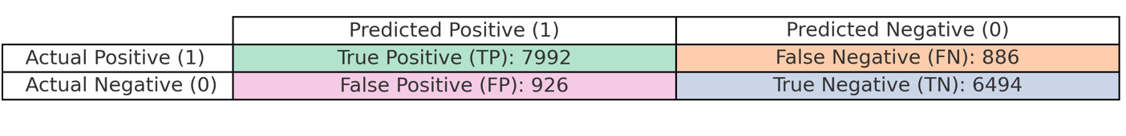
Model 3: Sentiment Classification Approach
Metric | Value | Interpretation
Accuracy | 0.8888 | About 89% of all reviews were correctly classified.
F1 Score | 0.8888 | A balanced measure of precision and recall – indicates reliable predictions.
Weighted Precision | 0.8888 | Our model predicts a sentiment, it's correct ~89% of the time.
Conclusion: Logistic regression model performs reliably across both positive and negative sentiment classes, with no major imbalance or bias.
After predicting review sentiment, we compared predictions to true labels to understand model performance using a confusion matrix.

Slide 29
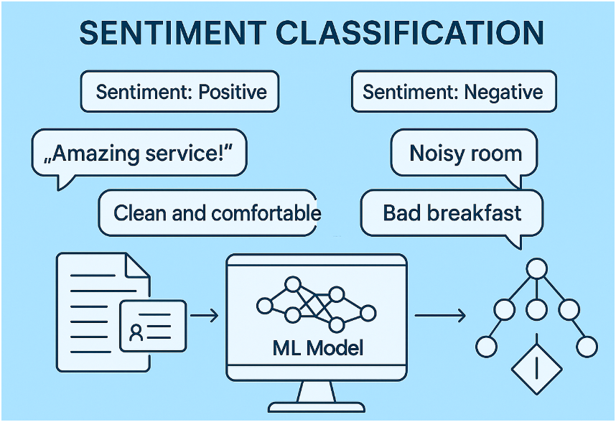
Classifying New Hotel Reviews Using a Trained ML Model
We use our trained machine learning pipeline to predict whether new hotel reviews are positive or negative based on their text.
Input: New Example Reviews
We manually entered a few hotel reviews, both positive and negative, to test the model's performance on unseen data.
Examples:
Positive: "The room was spotless and the staff were incredibly friendly."
Negative: "There was no hot water and the heater was broken."
ROOM 01
We:
Converted these reviews into a Spark DataFrame.
Used the trained pipeline to classify them
Extracted the prediction (1.0 for positive, 0.0 for negative) and the corresponding probability.
$ 2.900,56
Review Text | Prediction | Probability (Negative, Positive)
The room was spotless and the staff were incredibly friendly. | 1.0 | [0.1792, 0.8208]
There was no hot water and the heater was broken. | 0.0 | [0.8024, 0.1976]

Slide 30
Classifying New Hotel Reviews Using a Trained ML Model
We use our trained machine learning pipeline to predict whether new hotel reviews are positive or negative based on their text.
We manually entered a few hotel reviews, both positive and negative, to test the model's performance on unseen data.
Examples:
Positive: "The room was spotless and the staff were incredibly friendly."
Negative: "There was no hot water and the heater was broken."
Extracted the prediction (1.0 for positive, 0.0 for negative) and the corresponding probability.
Review Text | Prediction | Probability (Negative, Positive)
The room was spotless and the staff were incredibly friendly. | 1.0 | [0.1792, 0.8208]
There was no hot water and the heater was broken. | 0.0 | [0.8024, 0.1976]

Slide 31

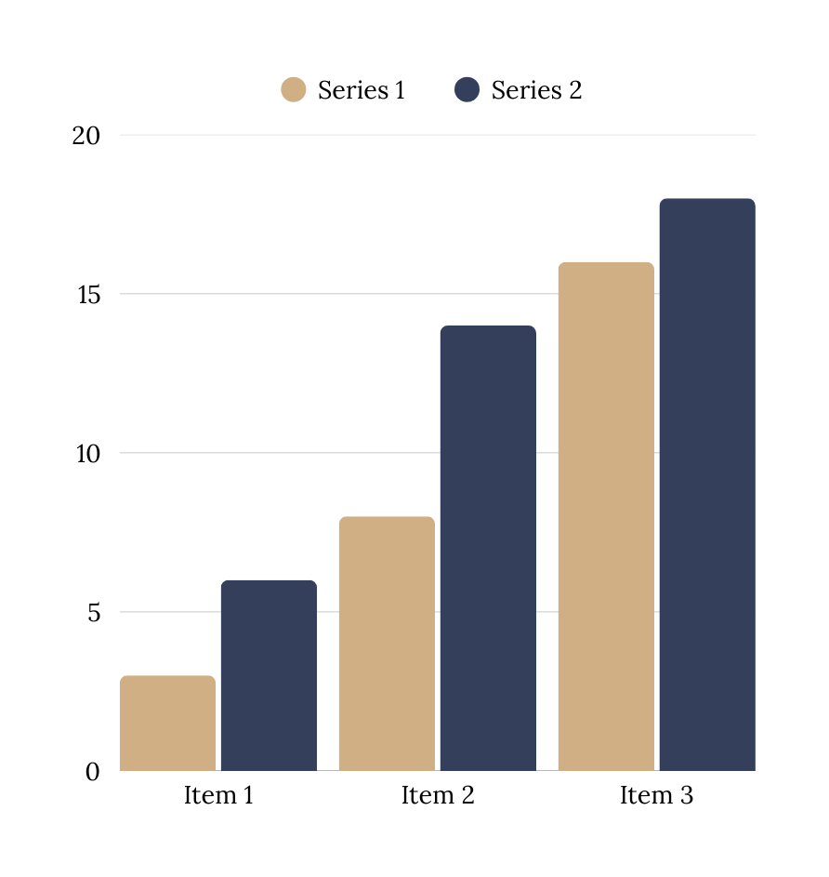
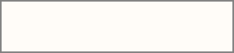
Sentiment Classification Model Applications
Customer Feedback Monitoring
Automatically classify reviews as positive or negative.
Track customer satisfaction trends over time.
Real-Time Alert Streaming System
Trigger alerts when negative sentiment crosses a threshold (e.g., many bad reviews in a short period).
Useful for hotels to respond quickly to service issues, crises.

Slide 32
Model 4: Hotel Star Rating Prediction using Review
In this part of the project, we shift from analyzing raw review text to working with aggregated numerical features derived from customer feedback. These features include:
Average review score
Number of review tags
Count of positive and negative lemmas
Total number of reviews per hotel
To simplify the prediction task, we created a new target variable called star rating, which maps each hotel’s average review score to a 1-to-5-star scale. This transformation allows us to approach the problem as a multi-class classification task, making it easier to evaluate model performance across distinct hotel quality levels.
Random Forest classifier (initial approach)

Slide 33
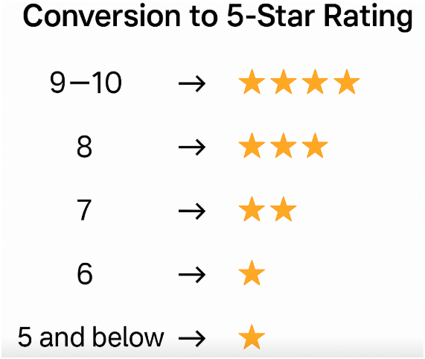

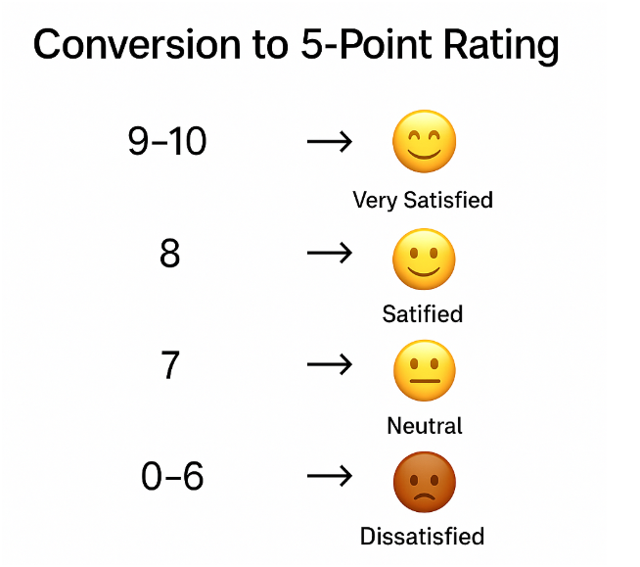
One of the strategies we applied was transforming the original hotel score from a 0–10 scale into a 1–5 star rating.
This allowed us to reframe the problem as a classification task and evaluate how well our model performs in predicting the perceived star quality of hotels based on their average customer review scores.
We could have changed the 0–10 scores into satisfaction levels.
For example, instead of using a star rating, we could classify scores into labels
such as Dissatisfied and Satisfied, which might better capture the emotional
tone behind the reviews and offer more interpretable insights for business decision-making.
SOO JIN AE
KIM CHUN HEI

Slide 34
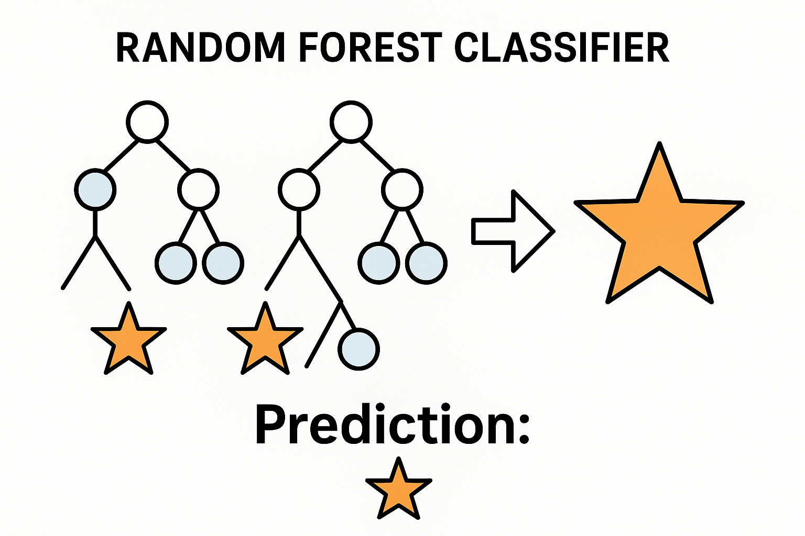
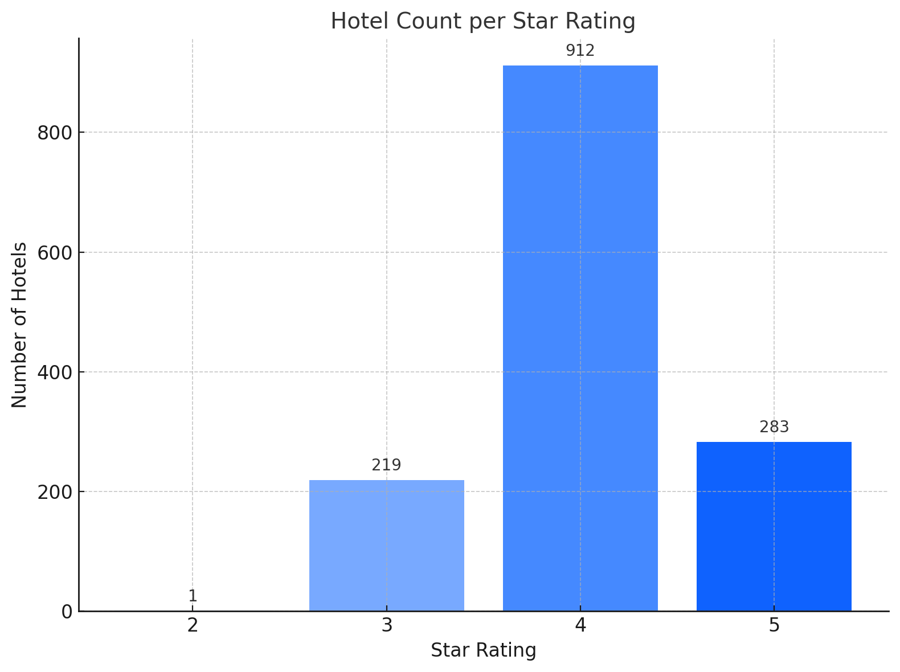
Random Forest Classifier Results
Before training our model, we analyzed the distribution of hotel star ratings in the dataset.
We included only 3,4 and 5-star hotels.
We built a Random Forest classifier to predict the star rating using
these features.
Split the dataset into training and test sets (80/20 split).
Trained the model using a machine learning pipeline with:
A Vector Assembler to combine features
A Random Forest Classifier to learn patterns Generated predictions
and compared the actual vs predicted star ratings for each hotel.

Slide 35
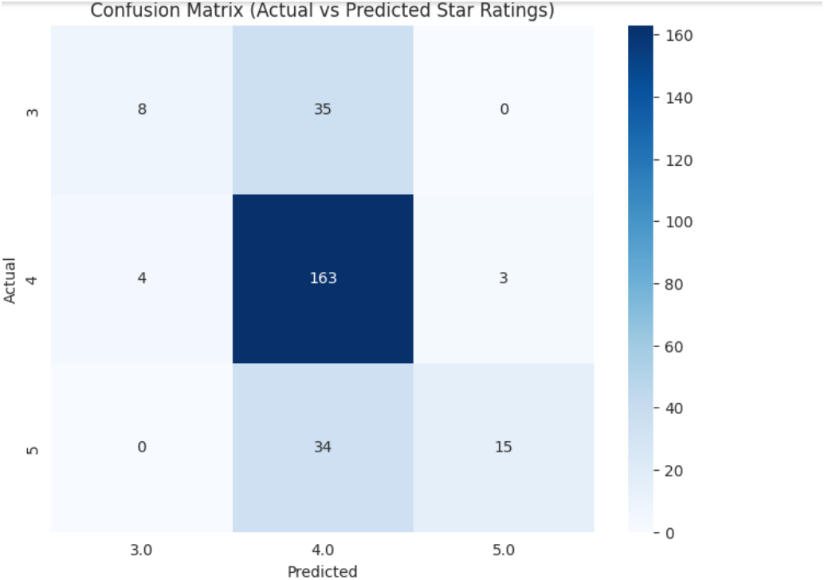
Confusion Matrix Insights
The majority of 4-star hotels were correctly classified (163 out of 170).
3-star hotels were often confused with 4-star ones (35 misclassified).
5-star hotels were also frequently predicted as 4 stars (34 misclassified).
This indicates that our model is biased toward the 4-star class, which is expected given the class imbalance.
Future improvements could involve resampling techniques or class weighting to handle the imbalance.
Metric | Score
Accuracy | 0.7099
F1 Score | 0.6577

Slide 36
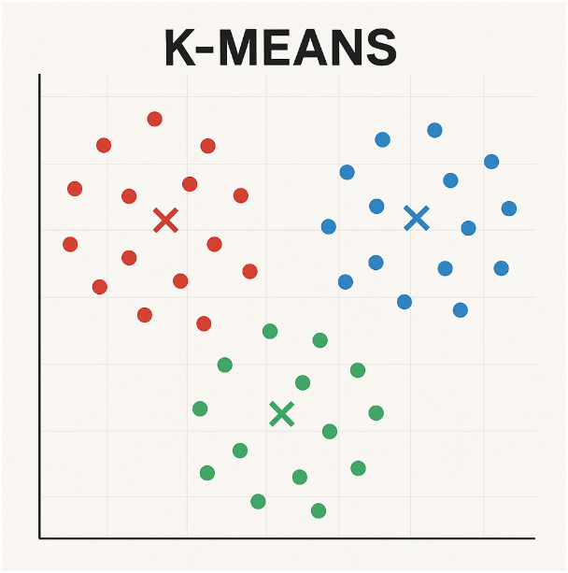
Clustering
We used these features :
Average review score
Number of positive and negative words
Number of review tagsTotal
Number of reviewsDays
We choosed the Best Number of Clusters (k)
A good k shows clear patterns in the data
What we did:
Tested k from 2 to 8
Calculated WSS (how tightly hotels fit in their group)
What we found:
WSS drops fast until k = 4, then slows down
This means k = 4 is a good choice → Balances simplicity and accuracy

Slide 37
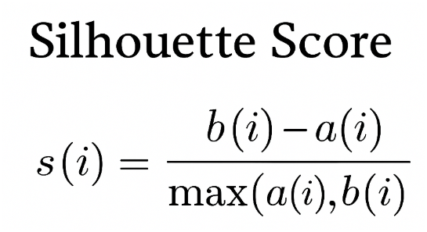
Clustering
Cluster | Size | Star Ratings | What It Means
Cluster 0 | Biggest group | Mostly ⭐4 and ⭐5 | Well-rated hotels with strong reviews
Cluster 1 | Medium size | ⭐4, some ⭐3 and ⭐5 | Hotels with mixed or average reviews
Cluster 2 | Medium size | ⭐4, some ⭐3 and ⭐5 | Similar to Cluster 1, but with small differences
Cluster 3 | Smallest group | Only ⭐3 and ⭐4 | Possibly less popular or more unique hotels
We calculated the Silhouette to see how well hotels fit into their clusters.
Score ranges from -1 to 1
Higher score ->better clusters
Helps us check if k = 4 was a good choice
Our result: Silhouette Score = 0.754
The clusters are clear and well-separated Hotels are grouped well
Our features worked well for clustering hotel reviews

Slide 38
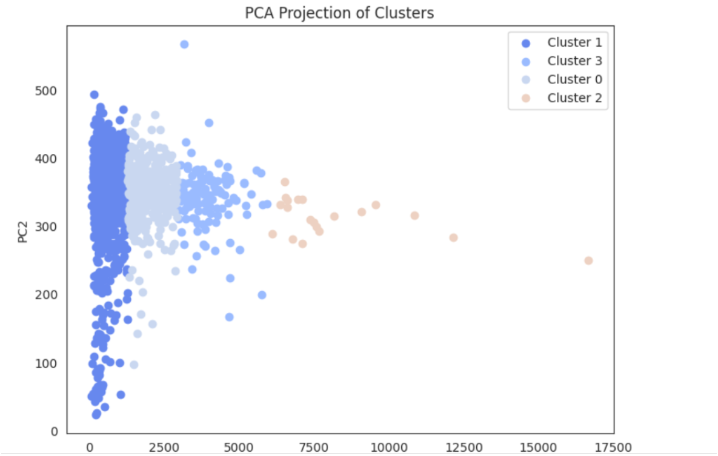
PCA-Principal Component Analysis
PCA Projection of Clusters.
This scatter plot shows how our data points are grouped into 4 clusters.
Each point represents a hotel or review, and the colors show which cluster it belongs to.
We used PCA to reduce the dataset to 2 dimensions (PC1 and PC2) so we can visualize it.
Key Insights:
Clusters 0, 1, and 3 are close to each other → They likely represent similar types of hotels or reviews.
Cluster 2 is far away → This group is very different from the others (could be hotels with very high review counts or unique features).
This helps us see patterns and similarities in the data more easily.

Slide 39
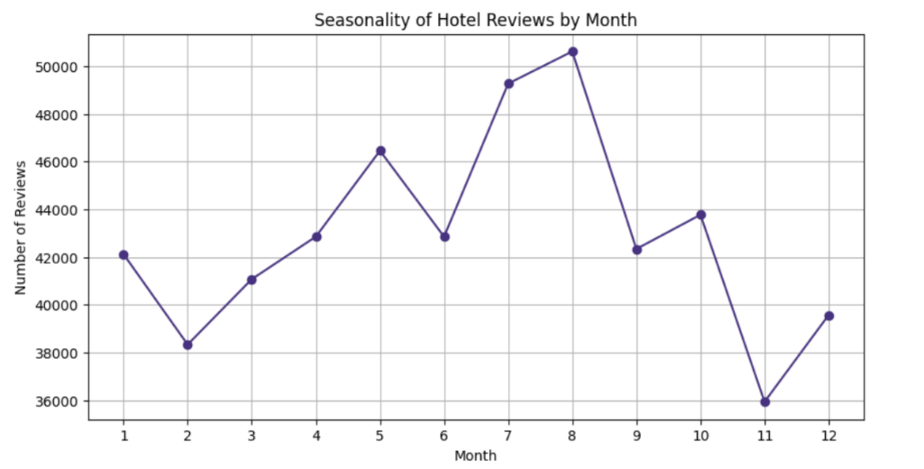
Limitations and further Analysis
Limitations:
Missing values: Too many blanks and null values making the dataset unreliable and biased
Unstructured text: Free-form reviews require a lot of pre-processing
Irrelevant Data: Non-informative content (irrelevant text like positive revies in the 'Negative_Reviews' column)
Large Volume: Required special tools and techniques
Further Analysis:
Utilize cross-validation for more robust model evaluation
We could also explore the seasonality of reviews to see if there are patterns across months or seasons.
For example, do hotels receive more negative reviews in summer due to overcrowding?
A next step could be to apply our approaches to the full dataset.

Slide 40
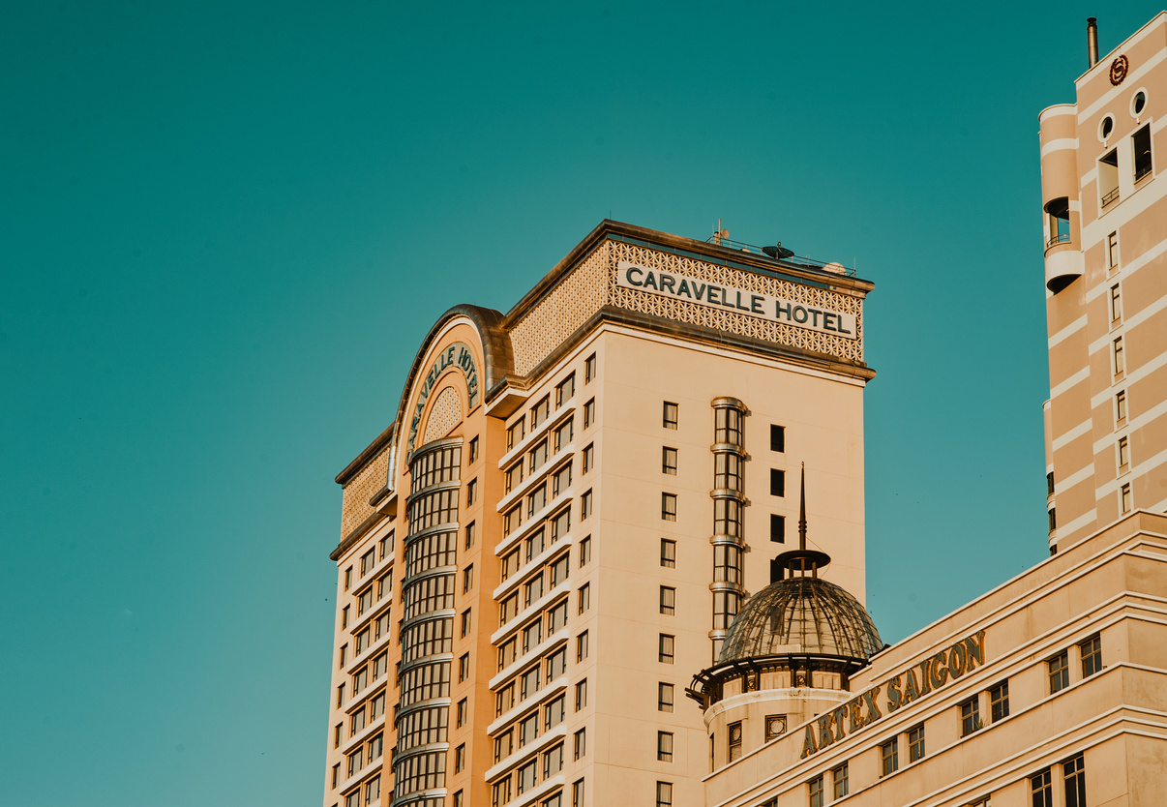

THANK YOU

Slide 41
Slide 5: Methodology
Text Cleaning: Already lowercase, no punctuation/unicode
NLP Techniques: Tokenization, Word Count, TF-IDF
Modeling: Regression, Clustering, Classification
Visualization Tools: Plotly, Seaborn, WordClouds, Folium
Slide 6: Sample Visualizations​
Map of hotel locations with Average_Score color-coded​
Word clouds for positive vs. negative reviews​
Boxplot of Reviewer_Score by Reviewer_Nationality​
Bar chart of top tags used by reviewers​
Slide 4: Possible Analysis Goals
Sentiment analysis on review texts
Identify which words are correlated with high/low scores
Clustering hotels based on guest preferences
Explore relationship between nationality and score
Build a simple recommendation system

